Slide 1
Impact of Climate Change on Solar Power Industry
Yutong Li, Xin Chen, Olina Song, Jerri Zhou

Slide 2
Agenda
Background & Target Audience
Data Visualization
Data Interpretation
Reflection

Slide 3
Background

Slide 4
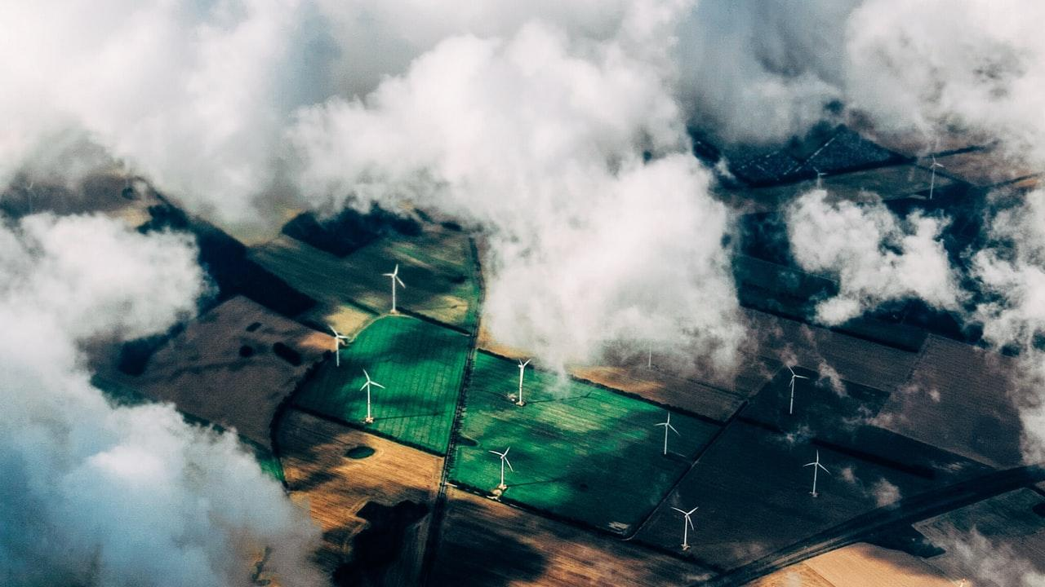

Slide 5
Maps

Slide 6
Data Visualization
Notes:
Indicates the relationship between climate change and solar power generation

Slide 7
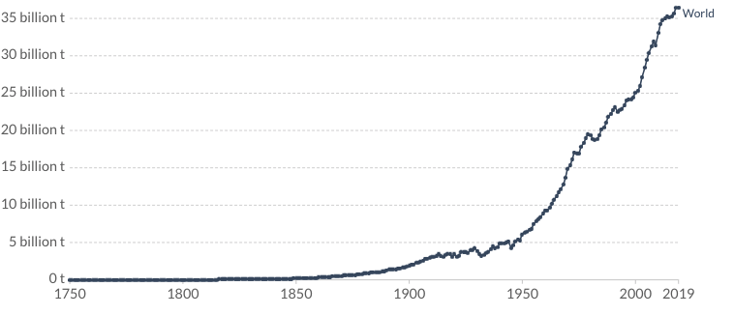
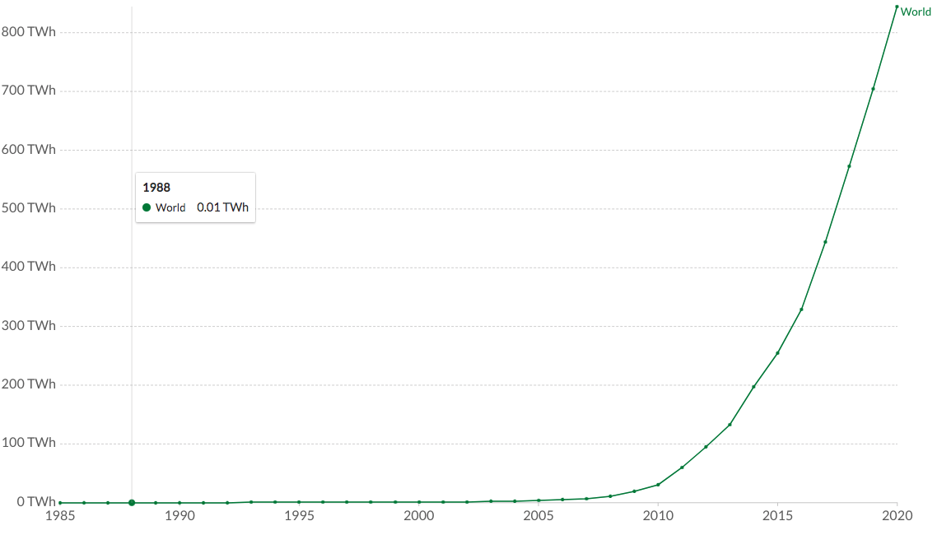
Annual CO2 Emissions
Correlation
(after log transformation): 0.961
Electricity Generation from Solar
Notes:
EXPONENTIAL TREND WITH NO SEASONALITY. They started at a constant level for the first few year and have a sharp increase after a specific year.
CO2 emission are highly correlated with solar power industry

Slide 8

Annual Change of solar power generation by country
Notes:
The darker the color turn, the more terawatt are being used in that country
US
As the year goes on, we see that Germany and Japan are the second and third countries start using solar power.
US, China, Germany and Japan

Slide 9
Data Interpretation

Slide 10
CO2 Emission Forecasting

Slide 11
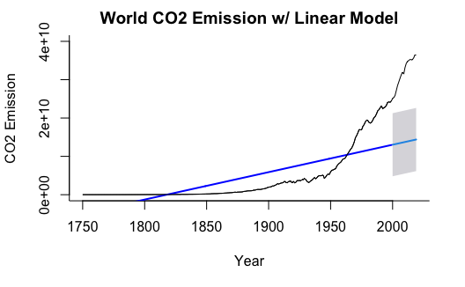
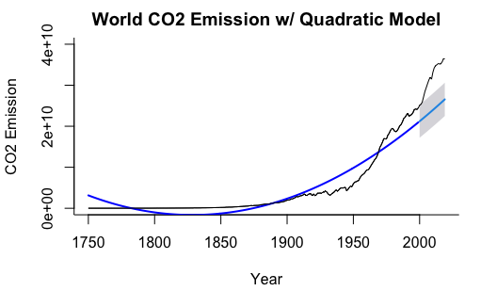
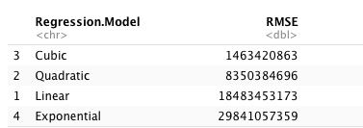
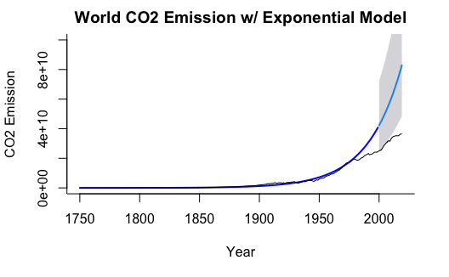
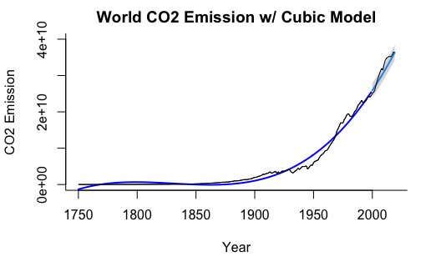
Regression Models

Slide 12
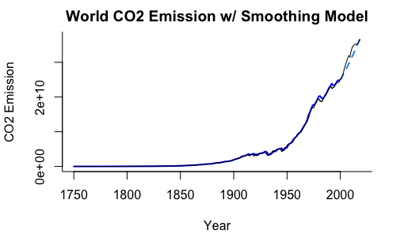
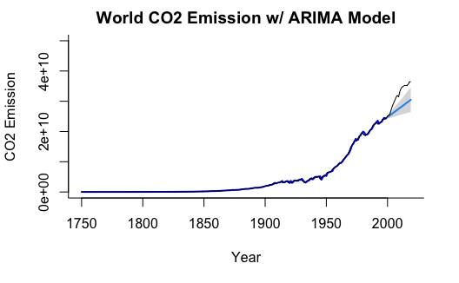
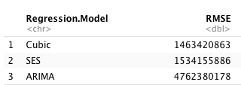
Smoothing Model
ARIMA(0,2,2)
ETS(M,M,N)

Slide 13
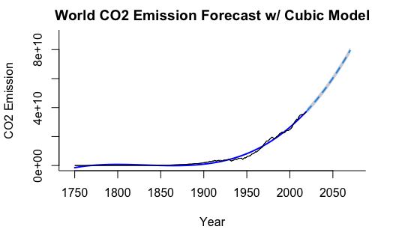
CO2 Emission Forecasting

Slide 14
Solar Energy Generation Forecasting

Slide 15
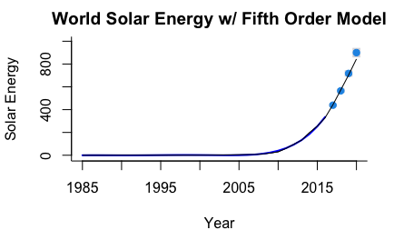
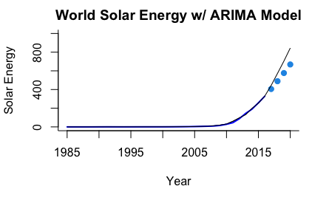
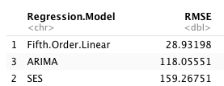
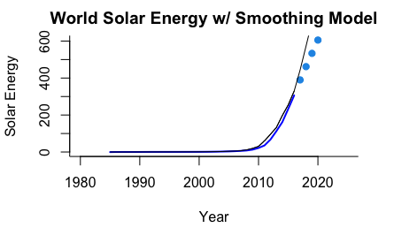
5th-Order Regression
ARIMA(2,2,2)
Smoothing Model
ETS(M,A,N)

Slide 16
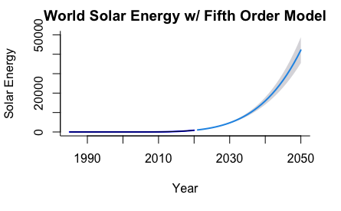
Solar Energy Forecasting

Slide 17

According to our
forecasting results…
65.6% CO2 increase
In 2050...
42134.70 (twh)
48.90 times more
A lot more CO2 Emission in 2050
More electricity generation from solar
Solar energy is growing fast!

Slide 18
Reflection

Slide 19
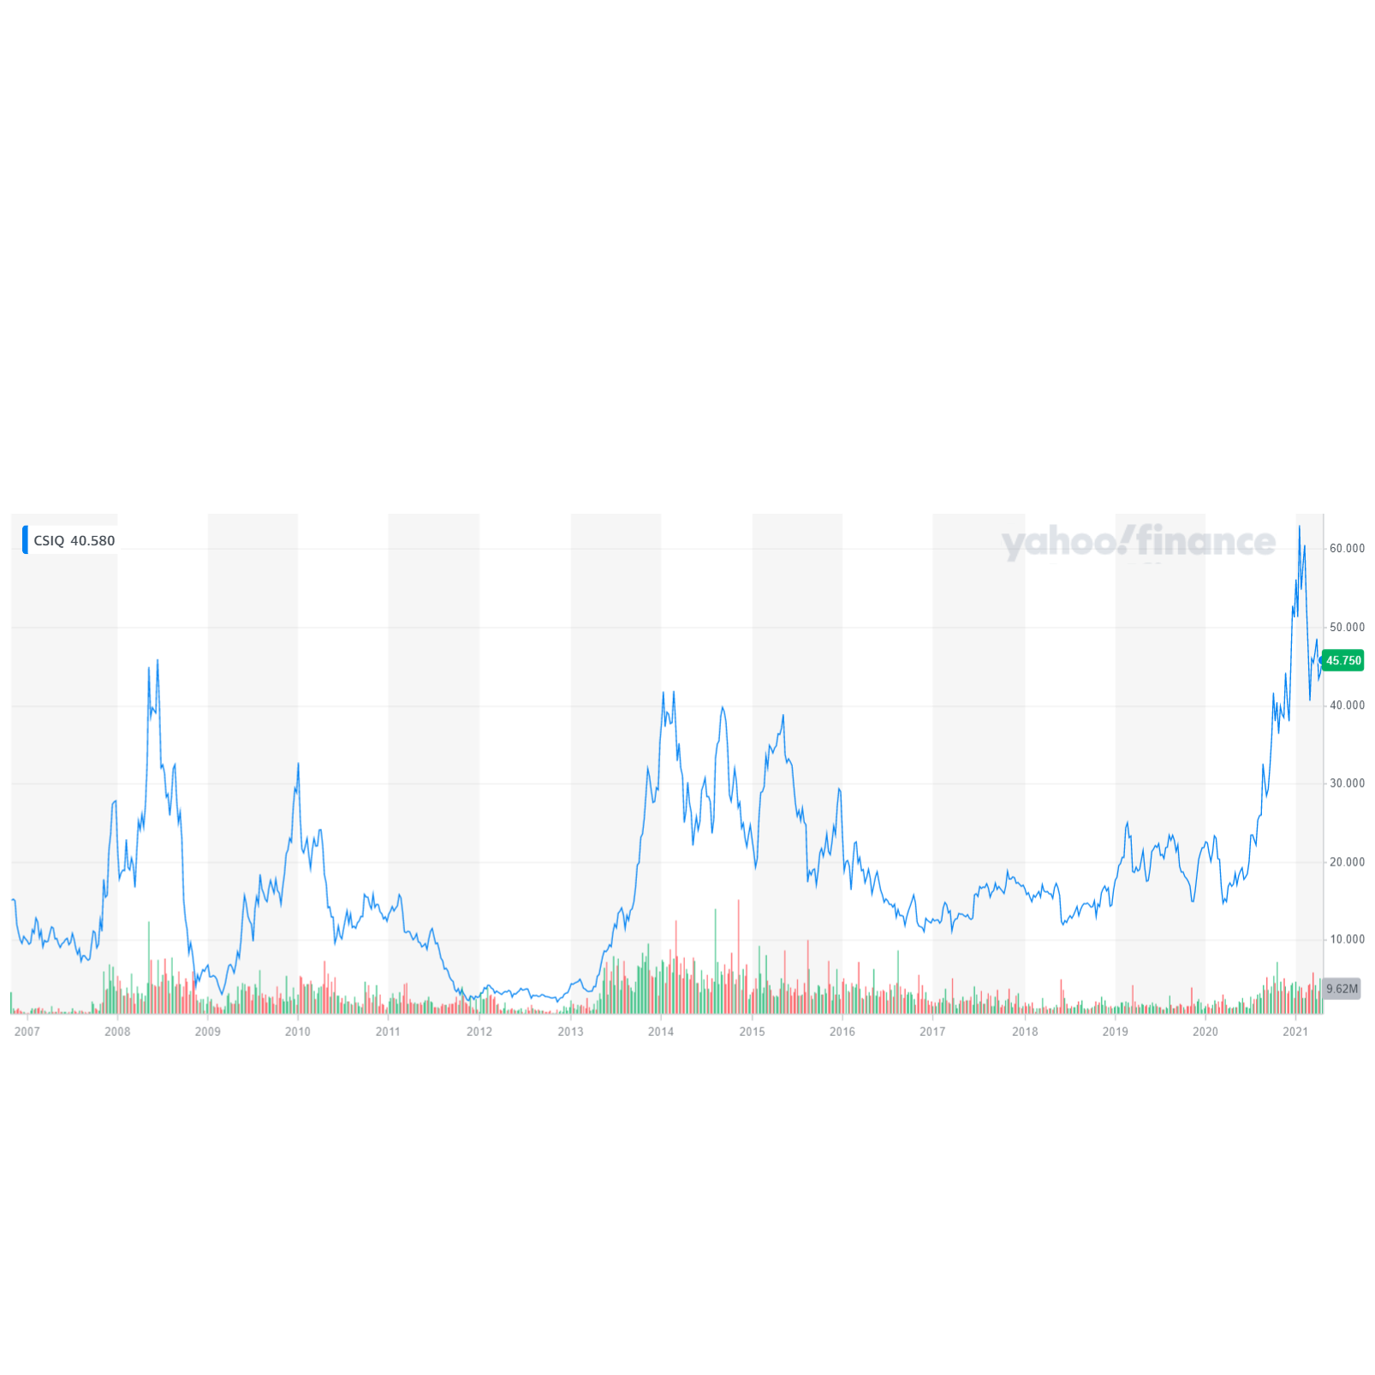
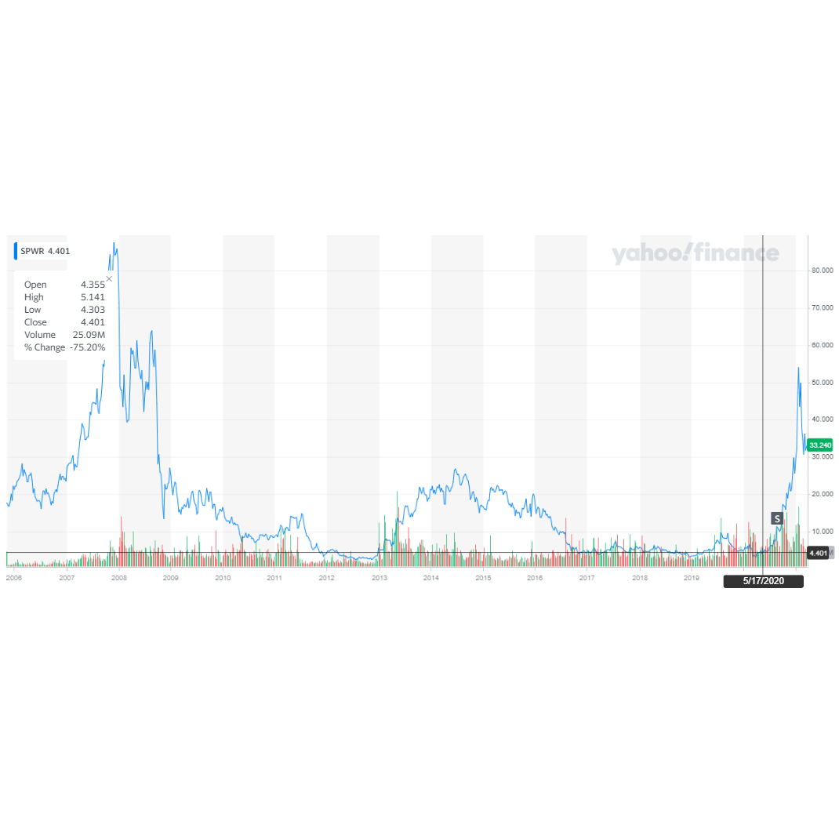
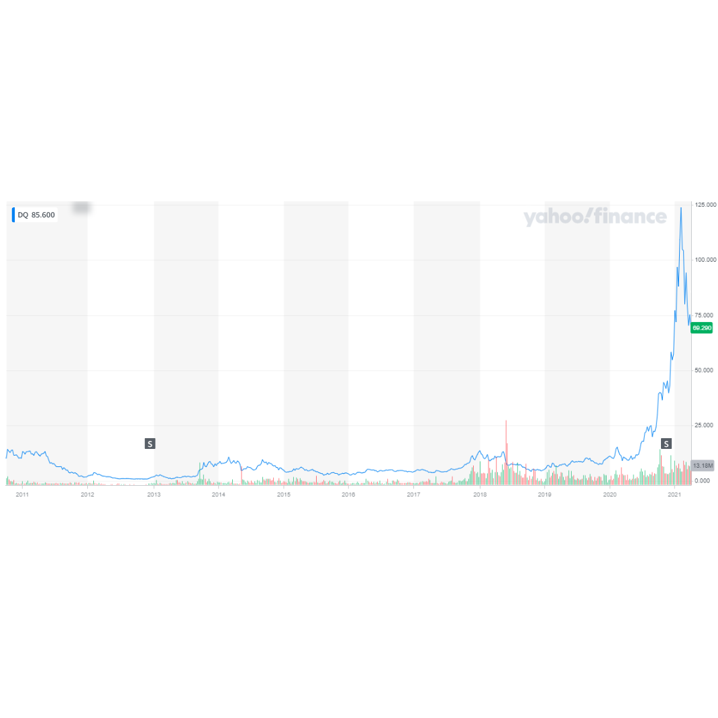
Canadian Solar Inc.
SunPower Corp.
Daqo New Energy Corp.
Notes:
Here we showed three stocks of companies that related to Solar that we found on yahoo finance. Those are Canadian Solar Inc, SunPower Corp, and Daqo New Energy Corp. Looking at the trend of these three companies we can clearly see that there is a overall upward trend for Canadian Solar Inc and Daqo New Energy but not for SunPower. All three companies are based on high solar power generation countries (Canada, USA, China), many companies started 2007 which is when solar power generation began to happen around the world based on the next slide.

Slide 20
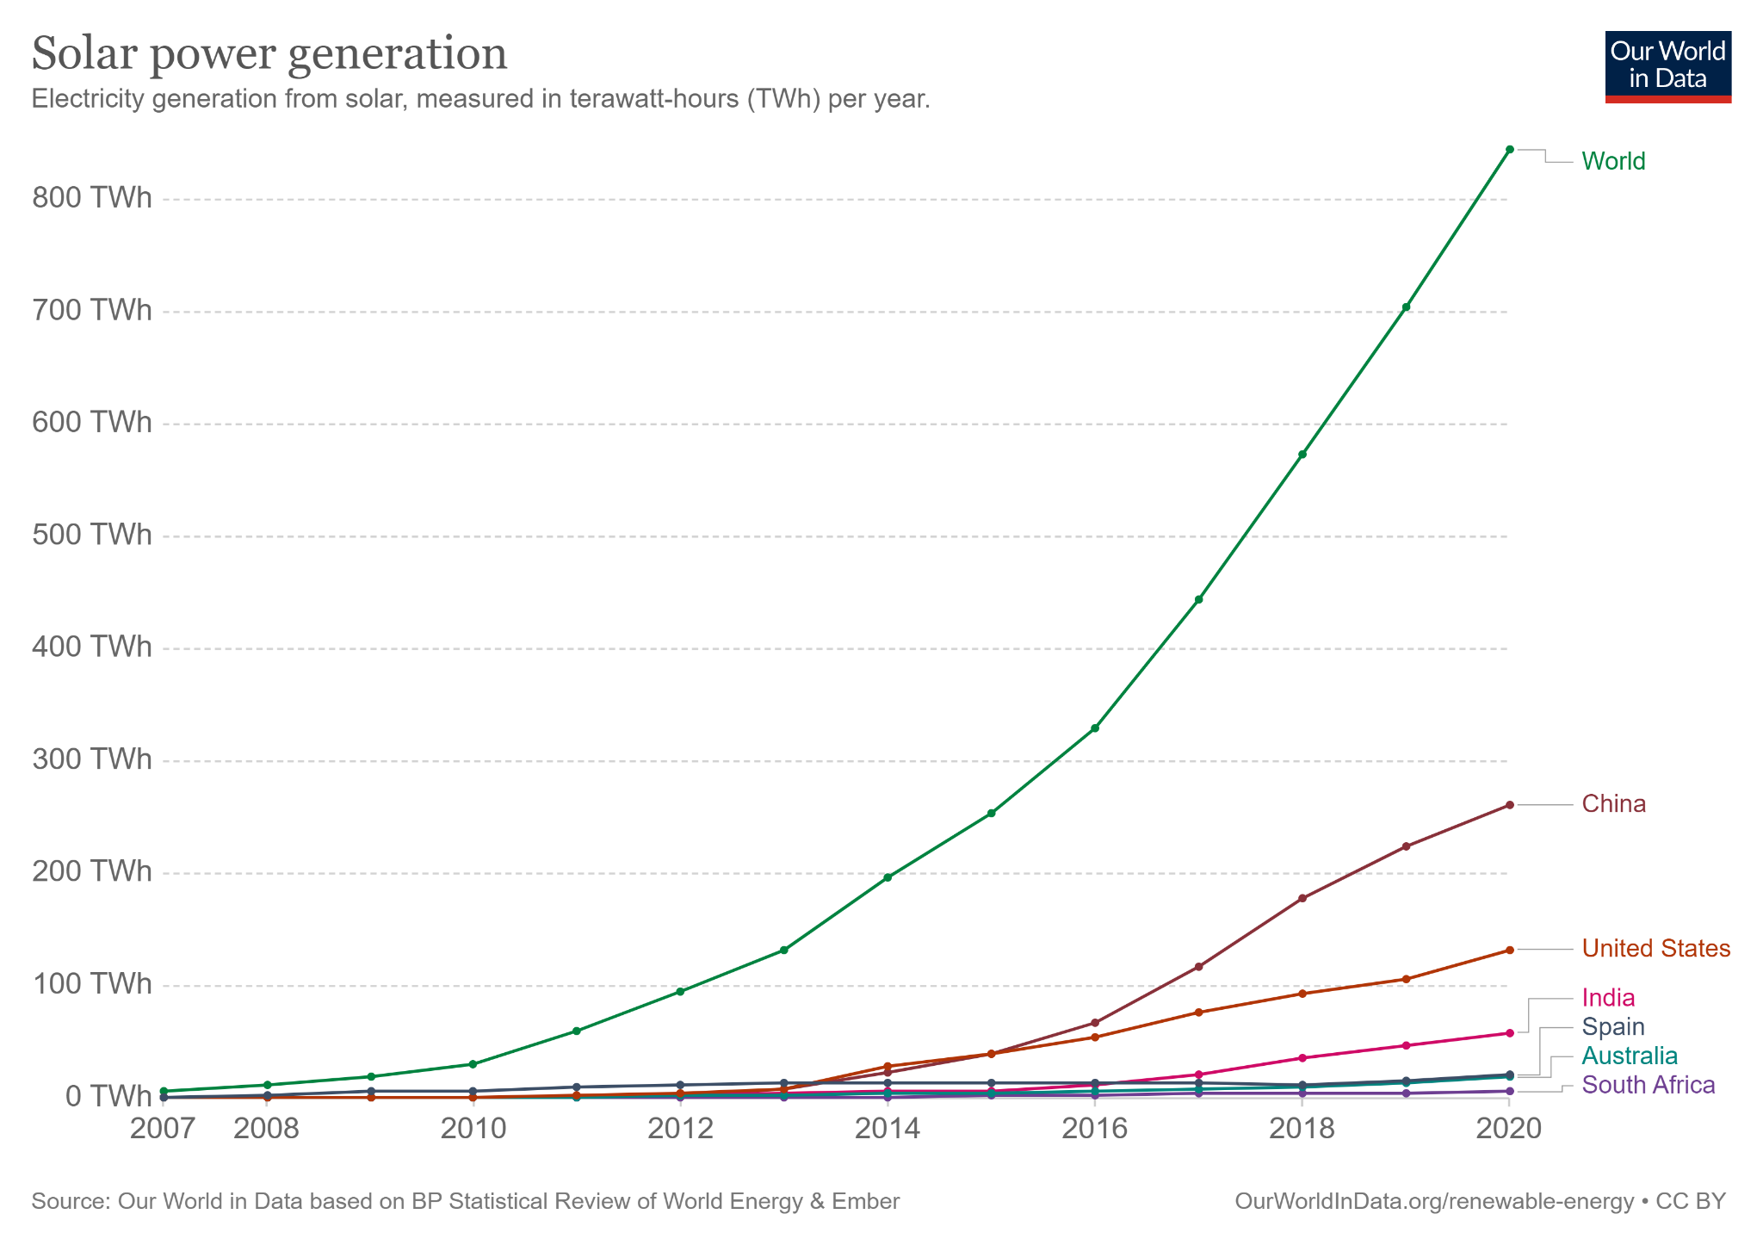

Slide 21

Further discussion:
Global vs. individual Countries
Stocks/companies that we can implement further into the discussion
Notes:
In our finding, we only focused on global-wided data but in order to have comprehensive knowledge, it is better to have more exploration into continent-wised and national-wised data. The discovery result might be different from our findings, but it will expand the expertise on Co2 emission and solar power industry.
In the previous discussion, we are not to find all the stocks that related to solar power generation, so in further discussion there could be more discussion about other companies related to solar power generation where we only focus on three companies and there are much more in the industry to be explored and analyzed.

Slide 22
Thank You!
We welcome to questions

